Slide 1
Genetic Algorithms
“Survival of the fittest”
Dr Yves Matanga

Slide 2
Outline
Advanced analytical Theory and Methods:
  Regression:
      Linear regression
      Logistic regression

Slide 3
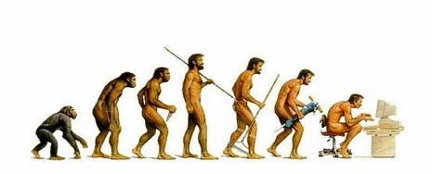
Genetic algorithms
Genetic algorithms are complex search methods inspired by the theory of evolution. It belongs to a larger family of evolutionary search methods.

Slide 4
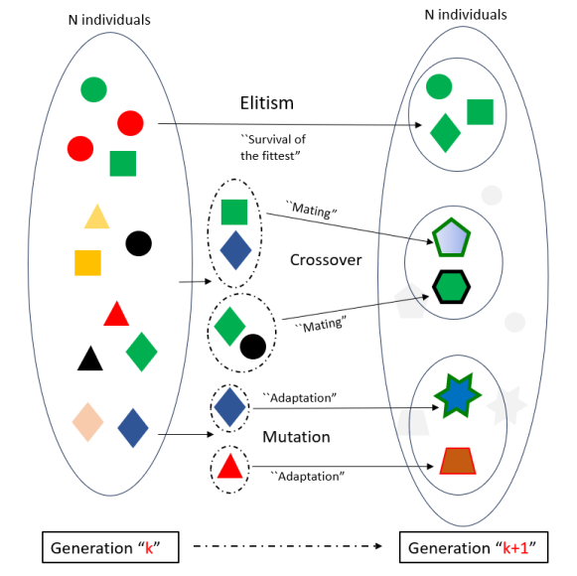
Genetic algorithm
    It is a population-based algorithm in which candidate optimisation agents possess genetic information and evolve over time generation after generation through three main evolutionary life processes:
    elitism, mutation and crossover.

Slide 5
Genetic algorithm
Genetic algorithm is centred on the idea that as a population evolves over time, better individuals, ``much fitter to the environment ’’ are formed in this evolutionary process, generation after generation.

Slide 6
Components of a genetic process
Genetic Code Formation
Fitness/Cost Function
Population Initialisation
Elitism
Crossover
Mutation

Slide 7

Genetic code
The Genetic code refers to the representation of a potential solution. It is analogous to the genetic material (DNA) in biological organisms. The genetic code represents the characteristics or parameters of an individual within the population.

Slide 8
Genetic code
Solutions are encoded as strings of symbols, often referred to as chromosomes. These strings are composed of genes, where each gene corresponds to a specific parameter or decision variable in the problem domain.

Slide 9
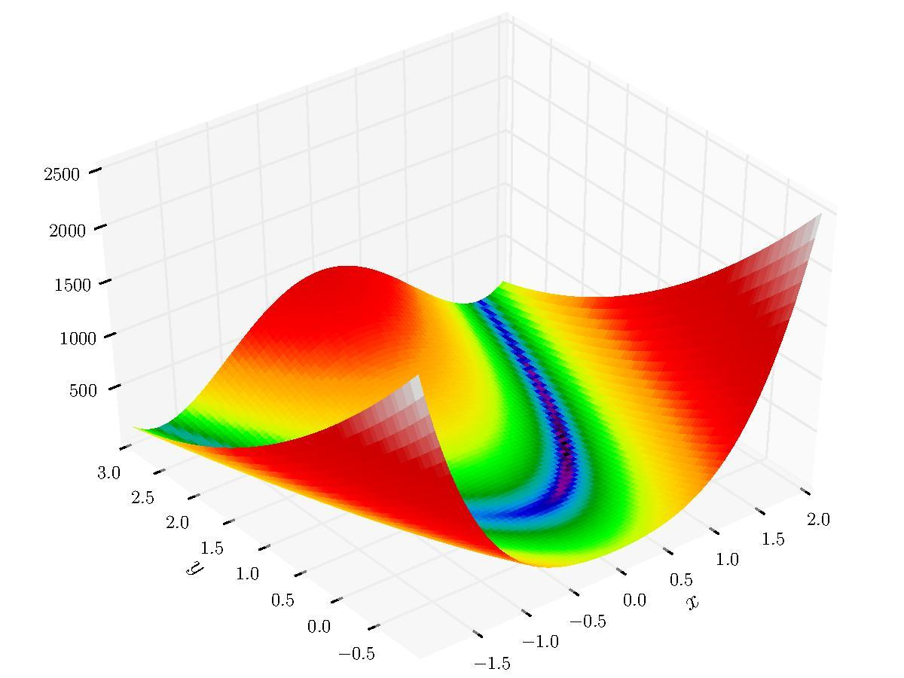
Fitness function
  Upon determining the genetic code of population individuals, a cost or fitness function (i.e. f(x)) must be defined that will quantify the performance of any given candidate solution.

Slide 10
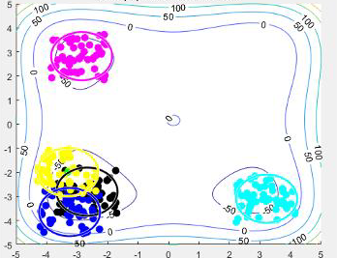
Population initialisation
  Genetic algorithms are population-based methods, they must be initialised with a given number of population individuals.

Slide 11
Elitism
Elitism is selection approach in genetic algorithms that guarantees that the fittest individuals move to the next generation.

Slide 12
Crossover
Crossover is the process in which two population individuals mate (“exchange genetic content”) with the hope of creating better breeds.

Slide 13
Mutation
Mutation is the process in which an individual modifies its genetic information to adapt to the environment.

Slide 14
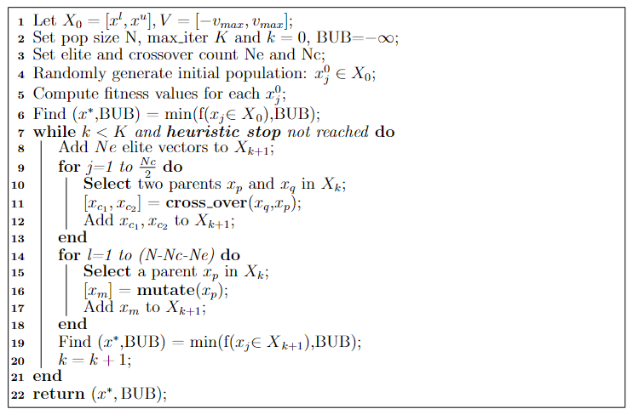
Typical GA pseudocode

Slide 15

Example problem: shortest route problem

Slide 16
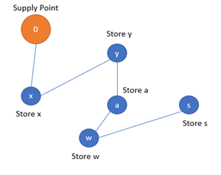
Shortest route problem
  Find the shortest route to deliver items from a main store to its multiple branches, assuming there are roads to move in between branches.

Slide 17
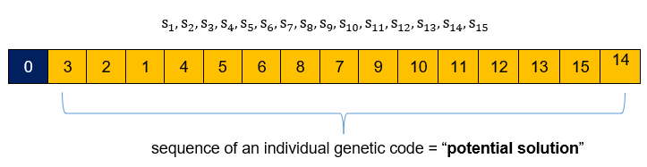
Genetic code formation
The problem consists of finding the best permutation of n stores. Thus, the genetic code of a population individual genetic code consists of a given permutation of the n stores.

Slide 18

Fitness function
The fitness function to solve the problem is the total distance from the supply point through branch to branch:

Slide 19
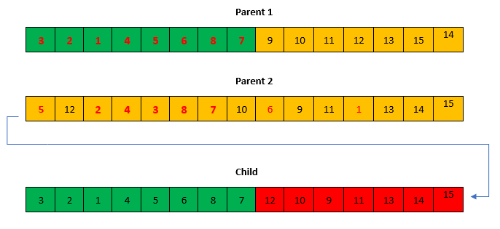
Crossover operator
Crossover is performed by inbreeding two parents to get a better individual of the -two. There could be several inbreeding approaches to the problem, nevertheless, an ordered crossover approach is used in the current implementation.
A portion of the genes of one parent is selected and appended in order and no repetition with the remaining genes of the other parent

Slide 20
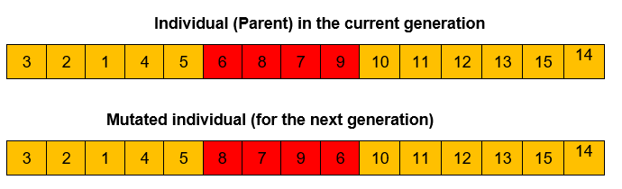
Mutation Operator
In the mutation process, a portion of the sequence is selected and reshuffled to create a new individual

Slide 21
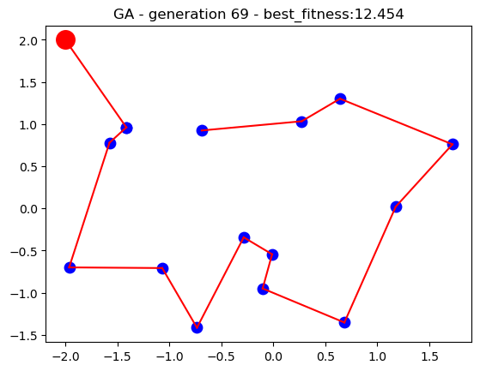
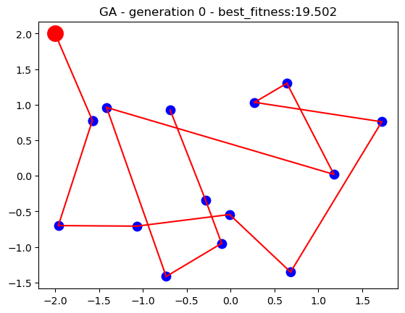
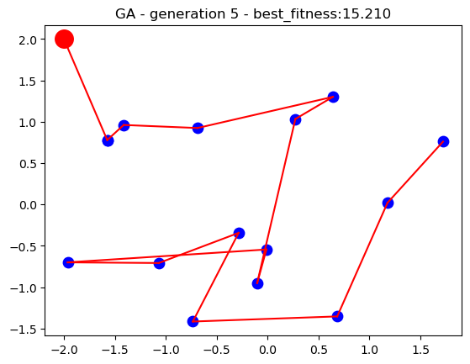
Search process - results

Slide 22
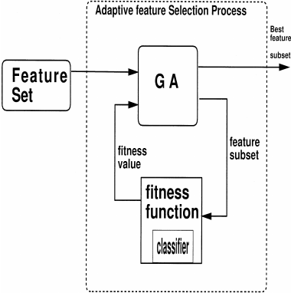
GA-based feature selection
Genetic algorithm can also be used for wrapped-based feature selection

Slide 23
Problem exercise
  Using the ``health-diabetes’’ datasets, and logistic regression, find an optimal feature subset. Make use of the sklearn-genetic package.
  You may use the attached template codes.

Slide 24
THANK YOU

